Slide 1
Autonomous Traffic Sign Detection and Recognition using CNN
MENTOR :
Dr.Ashvini K Babaleshwar
Presentation by :
Research student
ASHWINTH. r

Slide 2
Outline
Introduction
Objective
Dataset Info
Convolutional Neural Network
Model
Accuracy & Loss
Result
Reference

Slide 3
Introduction
Autonomous traffic sign detection and recognition play important roles in a variety of expert systems, including driver assistance and autonomous driving.
With minimal human work, it provides an accurate and timely solution to manage traffic-sign detections on road side. The great majority of existing techniques are effective at detecting traffic signs.

Slide 4
Objective:
To Develop a CNN Model that predicts and detects the various traffic sign
The traffic sign detection is based on Deep learning model by using data from various sources.
The Accuracy of the prediction should be greater than 80%.

Slide 5
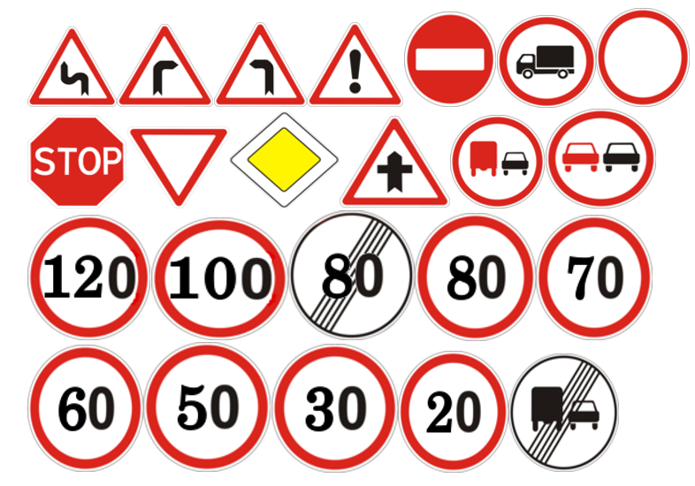
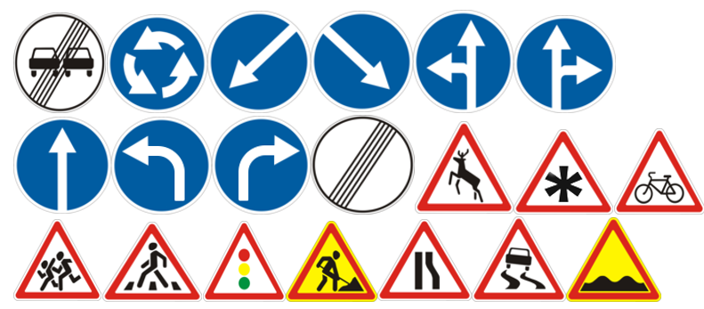
Dataset Info:
Traffic Sign data set (43 categories) :
Training : 39209 Images / Testing : 12631 Images

Slide 6
Convolutional Neural Network
A convolutional neural network (CNN) is a type of artificial neural network used in image recognition and processing that is specifically designed to process pixel data.
CNN is of Supervised learning Algorithm.
CNN uses a system much like a multilayer perceptron that has been designed for reduced processing requirements.

Slide 7
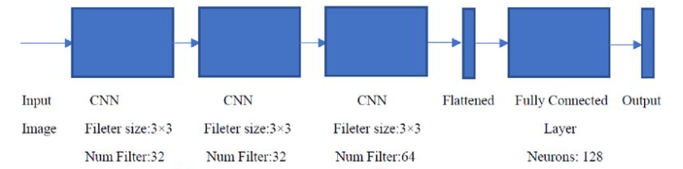
Model
Data Transformation
Resize all the Images into the same size e.g., 64 x 64
Normalize the greyscale of the images to [0,1]
Divide training data into training part and validation part
Size of validation data: 20%
Convolutional Neural Network + Fully Connected layers

Slide 8
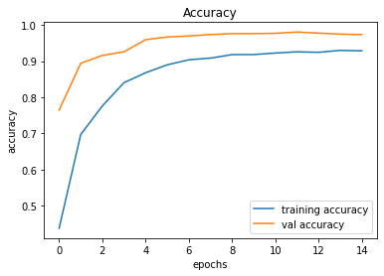
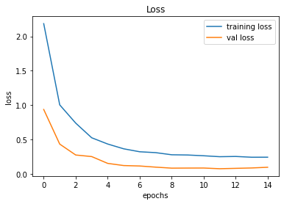
Accuracy and Loss
Totally 14 Epochs used to train the CNN Model
In the below Graphs we can see how our model getting trained and validated in each epochs.

Slide 9
Result
The experimental results show that the detection and recognition rate is good compared to other studies with precision and recall of 80% respectively
Predicting a autonomous traffic sign detection will benefits the autonomous car to know the worth and capabilities.
The Future enhancement of the project is to add more image and to increase the accuracy of the model upto 95%.

Slide 10
References
Shivanand S Gornale, Ashvini K Babaleshwar, Pravin L Yannawar," Detection and Classification of Signage’s from Random Mobile Videos Using Local Binary Patterns", International Journal of Image, Graphics and Signal Processing(IJIGSP), Vol.10, No.2, pp. 52-59, 2018.DOI: 10.5815/ijigsp.2018.02.06
Andreas Møgelmose, Mohan M. Trivedi, Thomas B. Moeslund, "Learning to detect traffic signs: Comparative evaluation of synthetic and real-world datasets", Pattern Recognition (ICPR) 2012 21st International Conference on, pp. 3452-3455, 2012.
Karthiga P. L, S. Md. MansoorRoomi, Kowsalya.J, “Traffic-Sign Recognition For An Intelligent Vehicle/Driver Assistant System Using Hog”, Computer Science & Engineering: An International Journal (CSEIJ), vol.6, No.1, pp: 16-23, February 2016.
Vishal R. Deshmukh, G. K. Patnaik, M. E. Patil, “Real-Time Traffic Sign Recognition System based on Colour Image Segmentation”, International Journal of Computer Applications (0975 – 8887) Vol.83, No3, pp: 30-35, December 2013
Md. Safaet Hossain, Zakir Hyder, “Traffic Road Sign Detection and Recognition for Automotive Vehicles”, International Journal of Computer Applications (0975 – 8887) Vol.120, No.24, pp: 11-15, June 2015.
Rabia Malik, Javaid Khurshid, Sana Nazir Ahmad, “Road Sign Detection And Recognition Using Colour Segmentation, Shape Analysis and Template Matching”, Proceedings of the Sixth International Conference on Machine Learning and Cybernetics, Hong Kong, pp:3556-3560, 19-22 August 2007.
Jack Greenhalgh and MajidMirmehdi, “Real-Time Detection and Recognition of Road Traffic Signs”, IEEE Transactions on Intelligent Transportation Systems, Vol.13, No.4, pp:1498-1506, December 2012.
Saturnino Maldonado-Bascón, Sergio Lafuente-Arroyo , Pedro Gil-Jiménez,Hilario Gómez-Moreno, Francisco Lopez-Ferreras, “Road-Sign Detection and Recognition Based on Support Vector Machines”, IEEE Transactions On Intelligent Transportation Systems, Vol.8, No.2, pp: 264-278, June 2007.

Slide 11
Thank You

